Slide 1
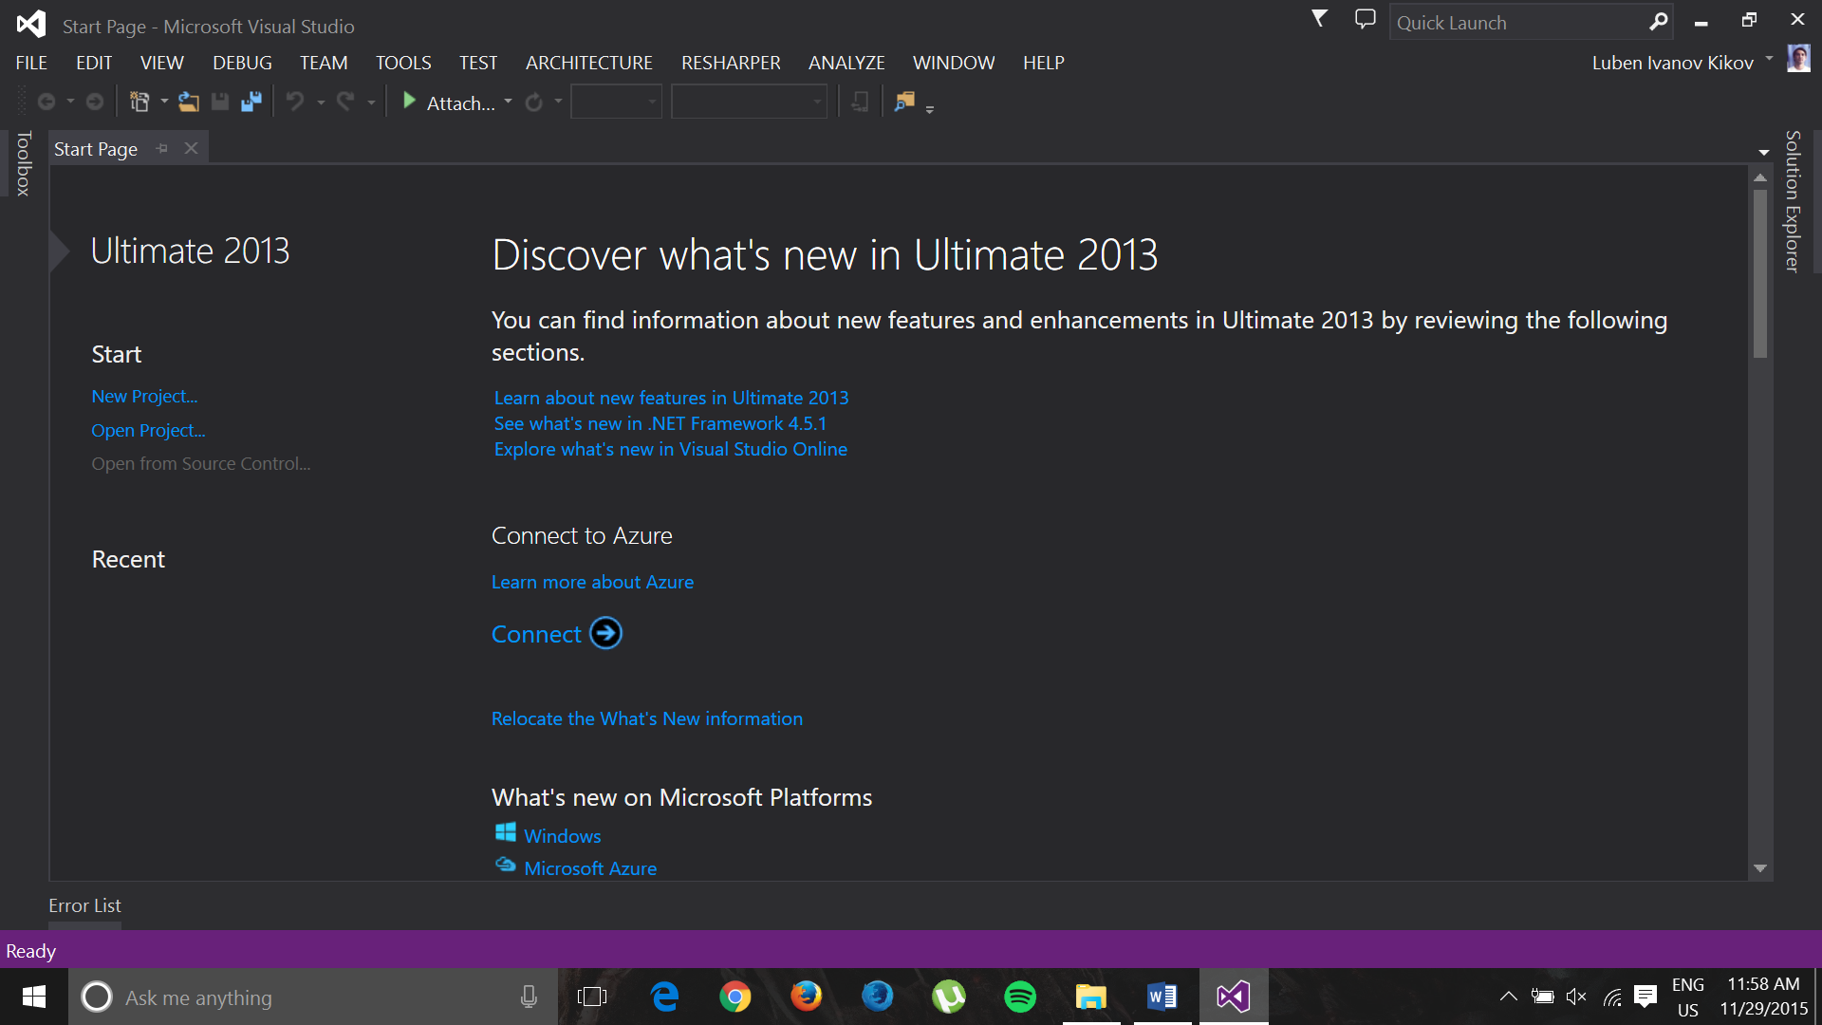

Table of Contents
Visual Studio Tips

Slide 2
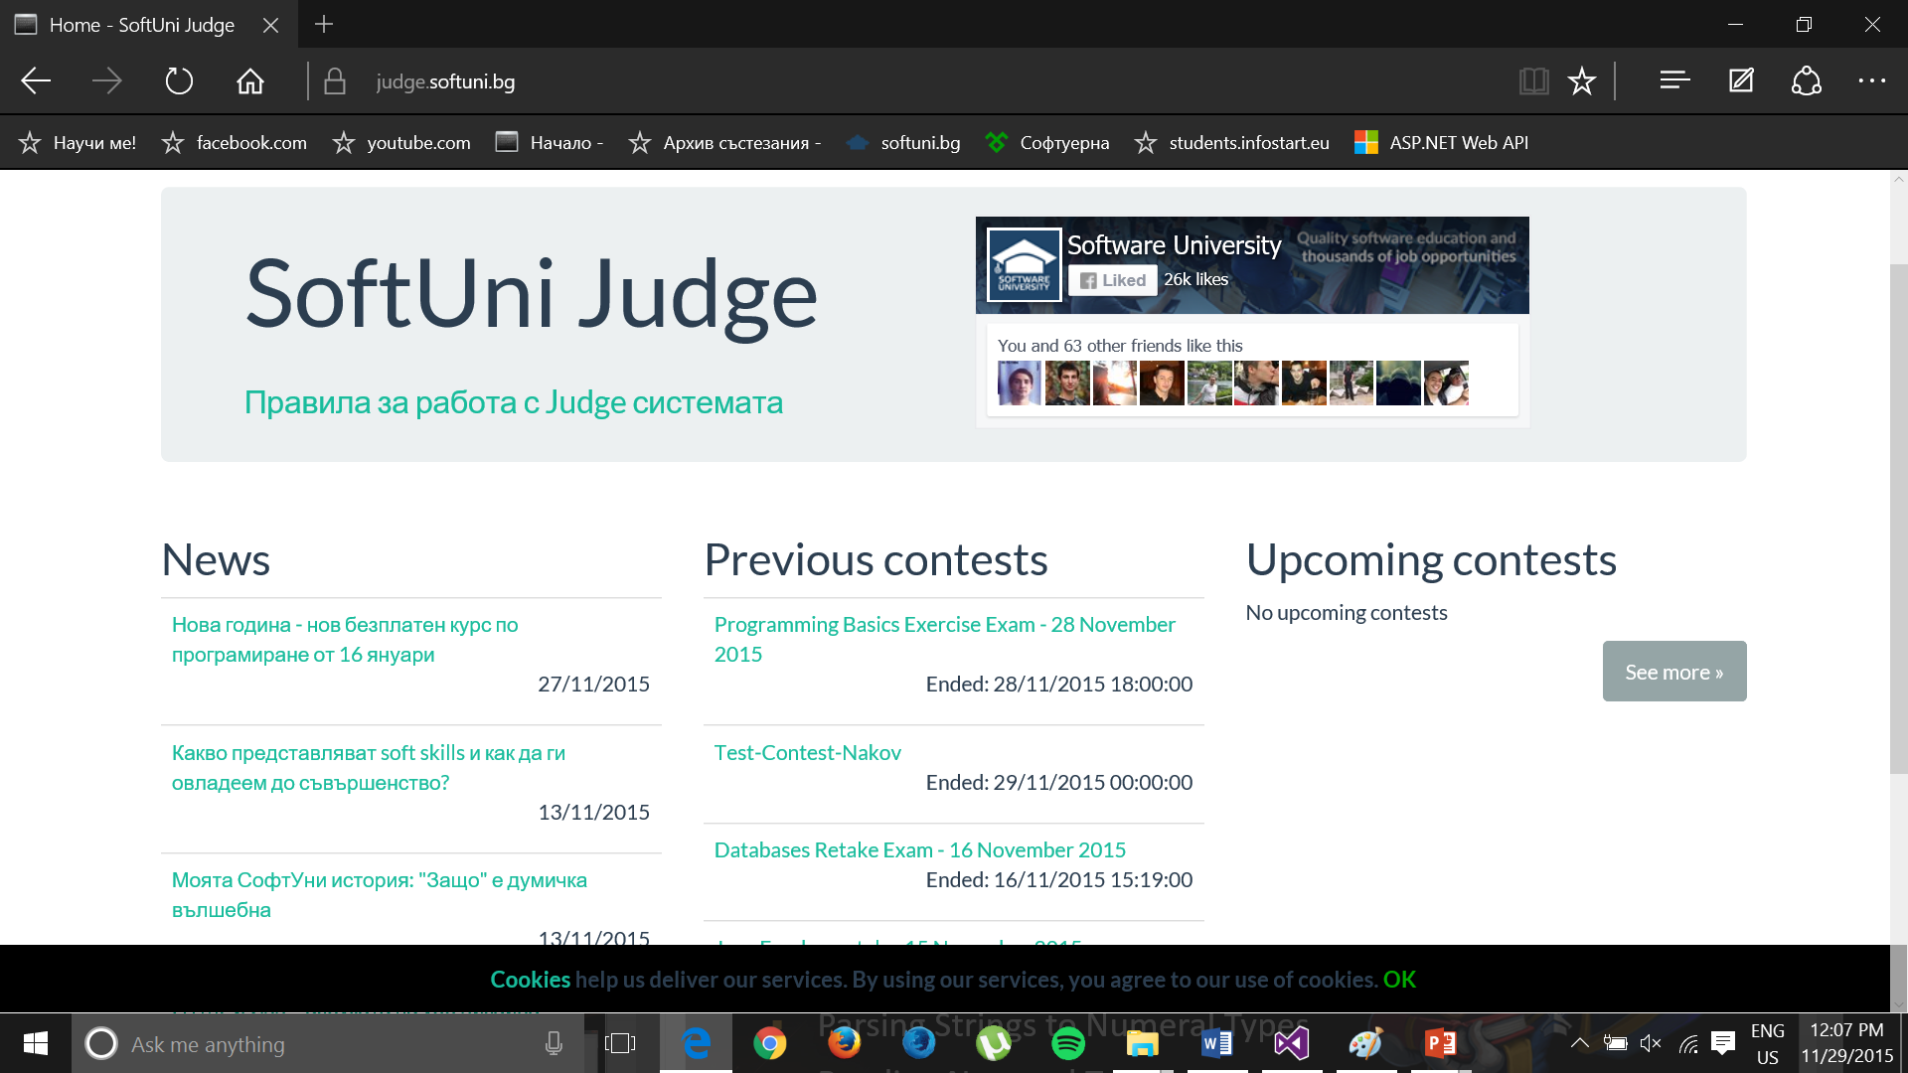
2. Judge System

Slide 3
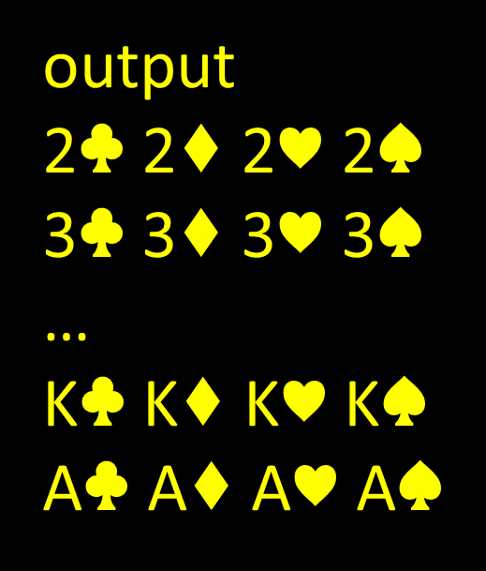
3. Print Deck of Cards:
4. Programming Basics Exam - 12 July 2015
Four Factors

